Slide 1
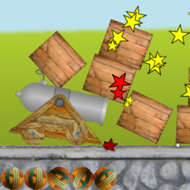
normalImpulse
tangentImpulse
localPoint

Slide 2

1
163
170
171
add
add
add
persist
add
172
225
226
243
remove
persist
add
persist
persist
remove
persist
add

